Slide 1

Cross Validation & Multiple Testing
Advait Patil
Rohit Dhonukshe
Ved Kokane

Slide 2
Data
The dataset comprises measurements from 200 diagnostic sensors in a semiconductor factory.
Each row represents a semiconductor chip, and there are 200 sensor readings (SIG1 to SIG200) for each chip.
The target variable, "FAIL," is a binary indicator (0 or 1) representing whether the chip is defective or not.

Slide 3

Policy Question
The chip manufacturer is concerned that maintaining all 200 sensors all throughout the plant is too costly. They would like to find out whether a smaller model that relies on the signals from only a smaller subset of the 20 sensors performs better than the large model when predicting chip defects. They hired us to assess the predictive performance of their current model and asked us to find a more cost-effective model that is equally good or ideally better than the current model.

Slide 4

Methodology
Exploratory Data Analysis
Logistic Regression
Benjamini- Hochberg Algorithm
Crossvalidation

Slide 5
Exploratory Data Analysis
Biased data
No duplicate values
No Null Values
Centered Data

Slide 6
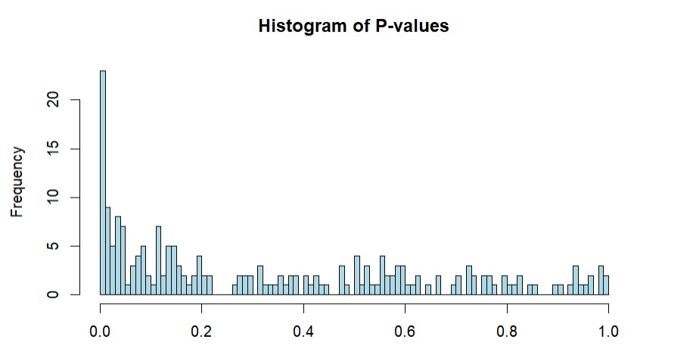
Logistic Regression

Slide 7
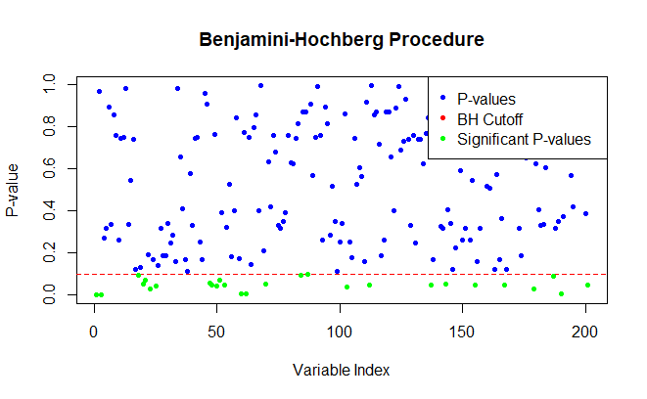
Benjamini – Hochberg Algorithm
Limited False Discovery Rate to 10%
Revealed 26 significant p-values
AIC value improved from 720 to 650 in logistic regression

Slide 8
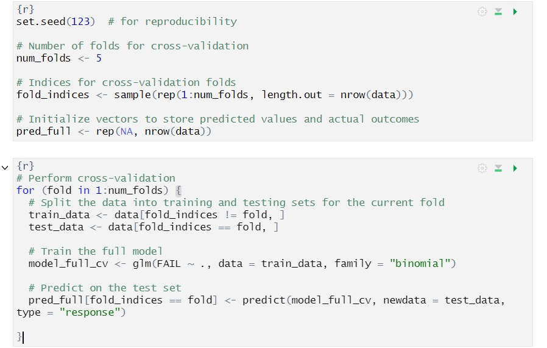
Cross Validation

Slide 9

Inferences & Empirical Results
R2 was calculated using binary cross-entropy
Negative value of R2 represents issues such as Imbalanced Data, Excessive Variability
Positive R2 is a significant improvement over the full model

Slide 10
Discussion & future scope
Identified significant sensors which effectively contribute towards determining chip quality
Additional sensors which are not contributing or harming the chip quality determination can be removed
Sensors which are very significant can be allocated more resources instead of the sensors which do not contribute
The factory should adopt this new small model for detecting defective chips

